Slide 1
Object Oriented Programming(Java) Lecture 18

Slide 2
Content
Java File Handling
Methods of File class
Java Create and Write To Files
Get File Information
Java Delete Files

Slide 3
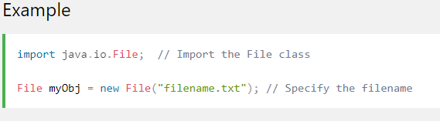
Java File Handling :
The File class from the java.io package, allows us to work with files.
To use the File class, create an object of the class, and specify the filename or directory name:

Slide 4
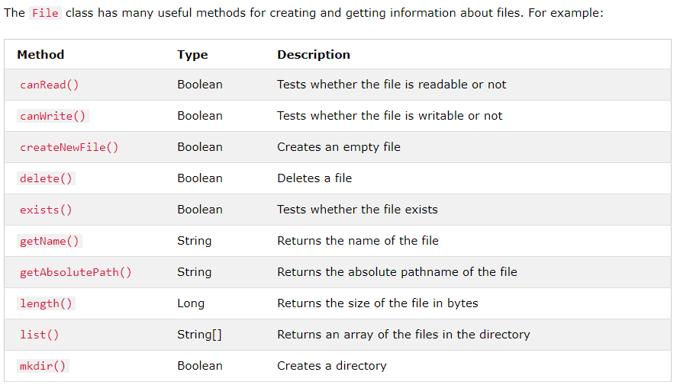
Methods of File class :

Slide 5
Create a File:
To create a file in Java, you can use the createNewFile() method. This method returns a boolean value: true if the file was successfully created, and false if the file already exists. Note that the method is enclosed in a try...catch block. This is necessary because it throws an IOException if an error occurs (if the file cannot be created for some reason).

Slide 6
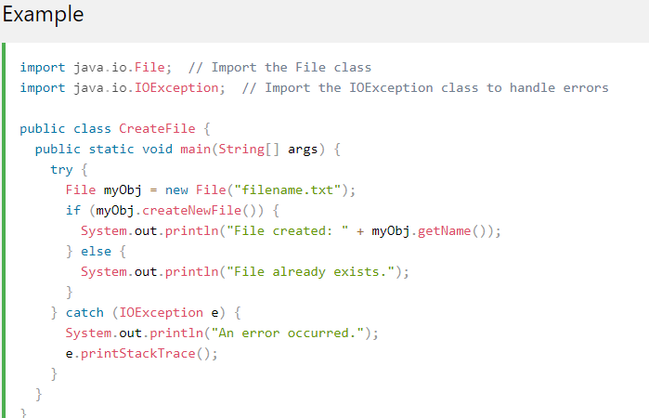
Create a File:

Slide 7

Create a File:

Slide 8
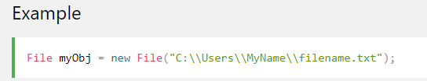
Create a File:
To create a file in a specific directory (requires permission), specify the path of the file and use double backslashes to escape the "\" character (for Windows). On Mac and Linux you can just write the path, like: /Users/name/filename.txt

Slide 9
Write To a File :
In the following example, we use the FileWriter class together with its write() method to write some text to the file we created in the example above. Note that when you are done writing to the file, you should close it with the close() method:

Slide 10
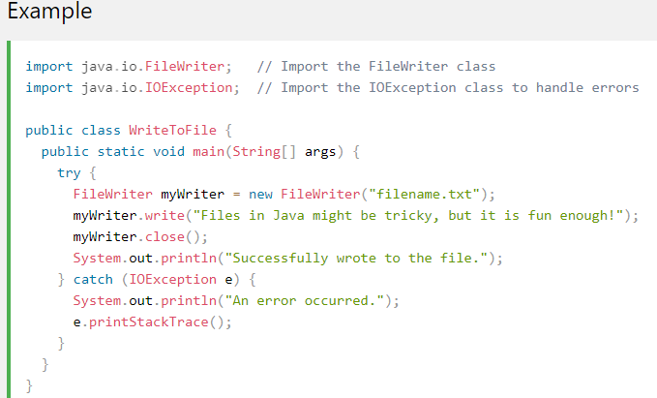
Write To a File :

Slide 11

Write To a File :

Slide 12
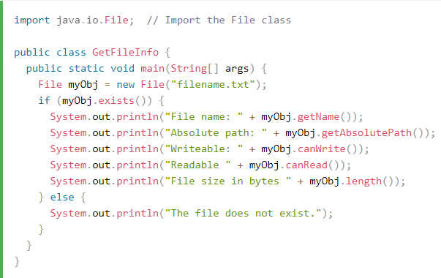
Get File Information :

Slide 13
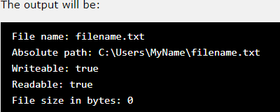
Get File Information :

Slide 14
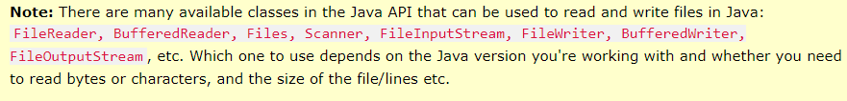
Get File Information :

Slide 15
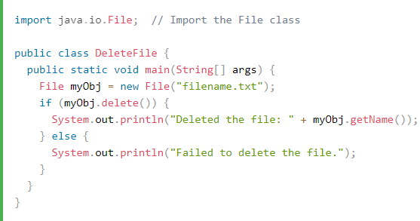
Java Delete Files :
To delete a file in Java, use the delete() method:

Slide 16

Java Delete Files :

Slide 17
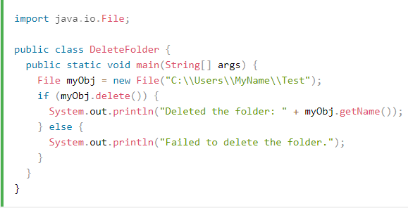
Delete a Folder :
You can also delete a folder. However, it must be empty:

Slide 18

Delete a Folder :

Slide 19
References :
https://www.w3schools.com/java/java_files.asp
https://www.w3schools.com/java/java_files_create.asp
https://www.w3schools.com/java/java_files_read.asp
https://www.w3schools.com/java/java_files_delete.asp

Slide 20
Thanks

